Slide 1
Generalized Group Lasso for Predictive Biomarkers Selection
Wenxuan Deng
Working with Kevin Galinsky and Jacob Zhang

Slide 2
Outline
Background
Model
Simulations
Conclusions

Slide 3
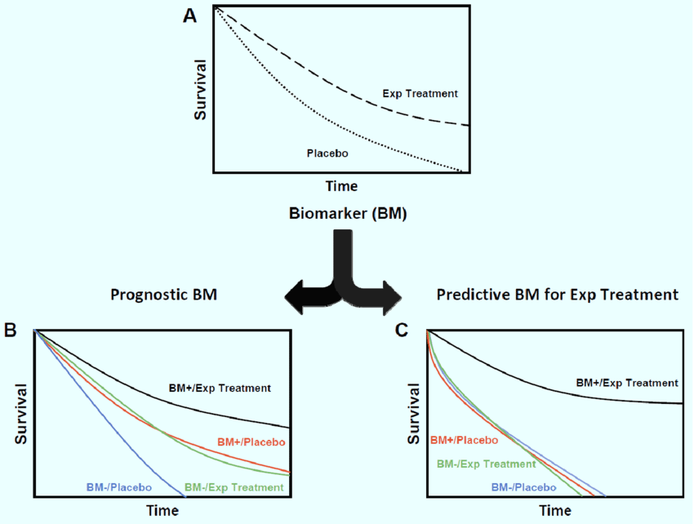
Prognostic Biomarkers and Predictive Biomarkers
T Tran, P., et al. Current molecular medicine 12.6 (2012)

Slide 4
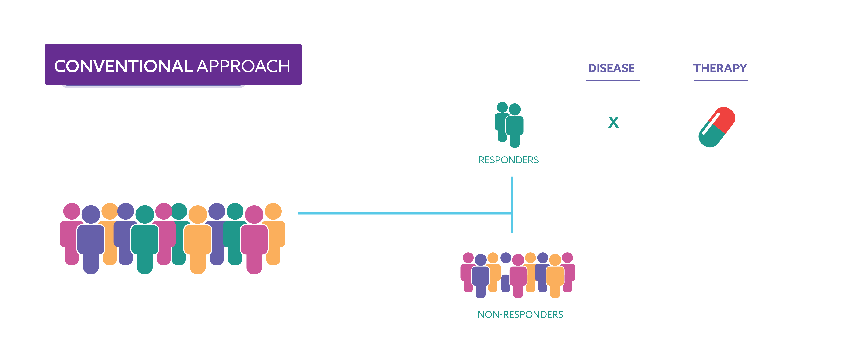
Patient Subgroup Identification
X
X

Slide 5
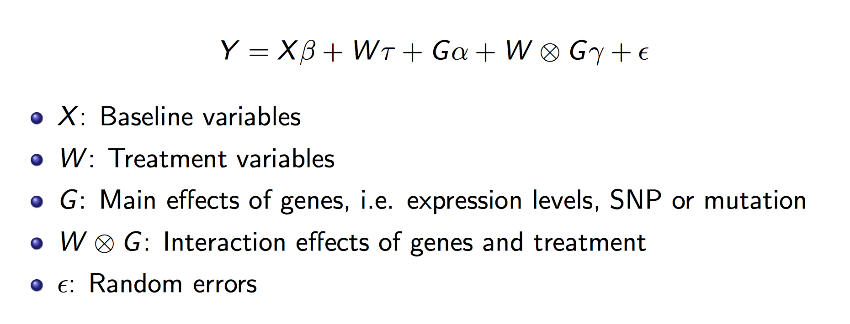
Model

Slide 6
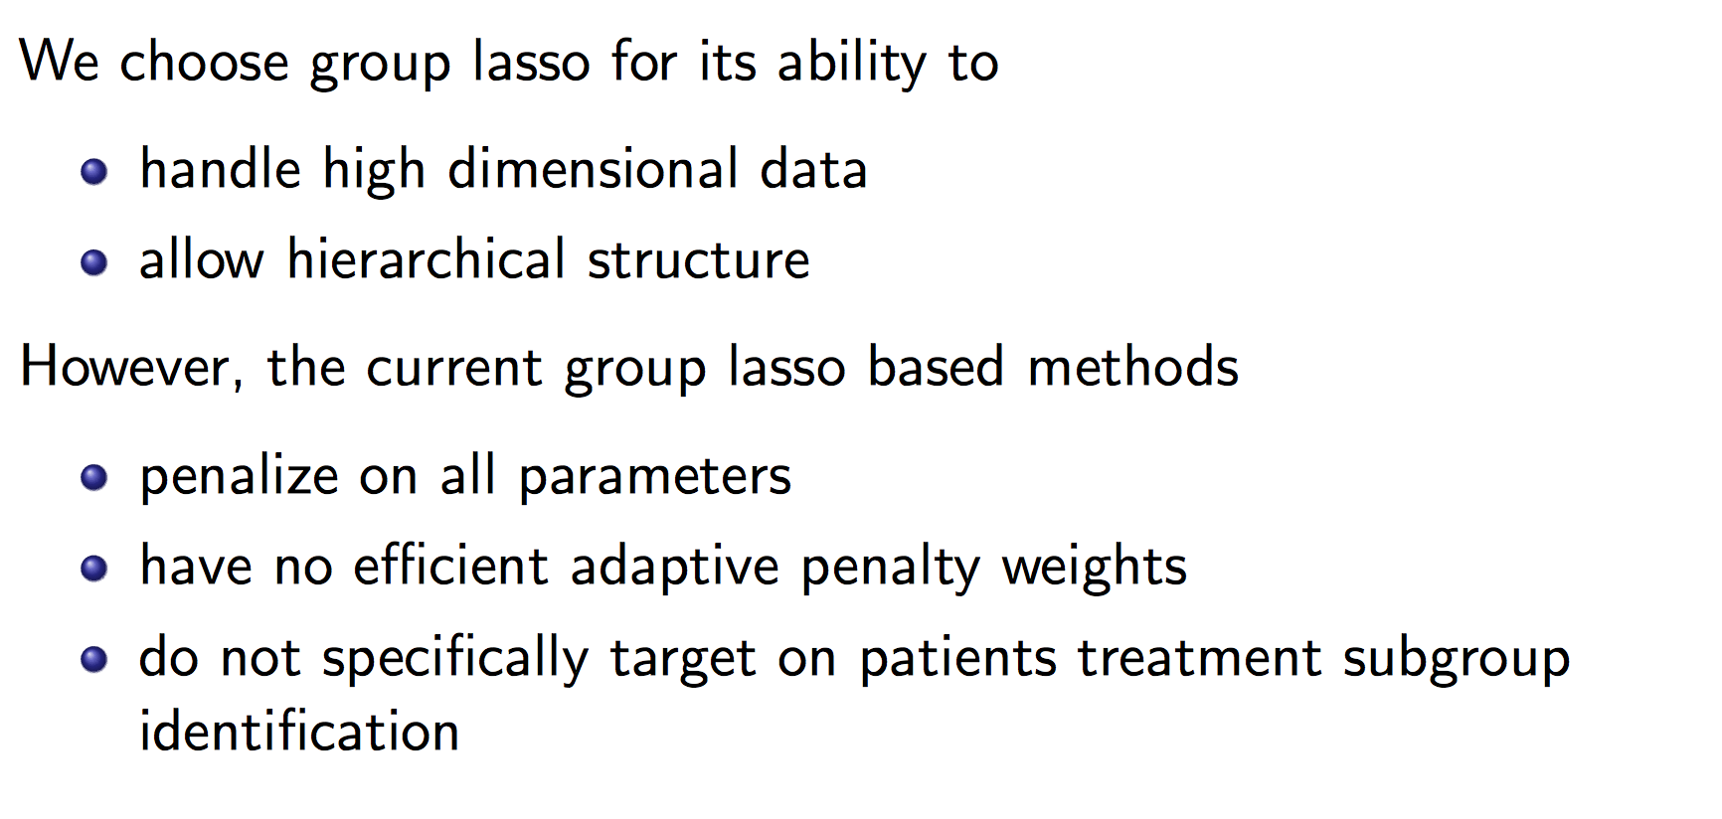
Group Lasso

Slide 7
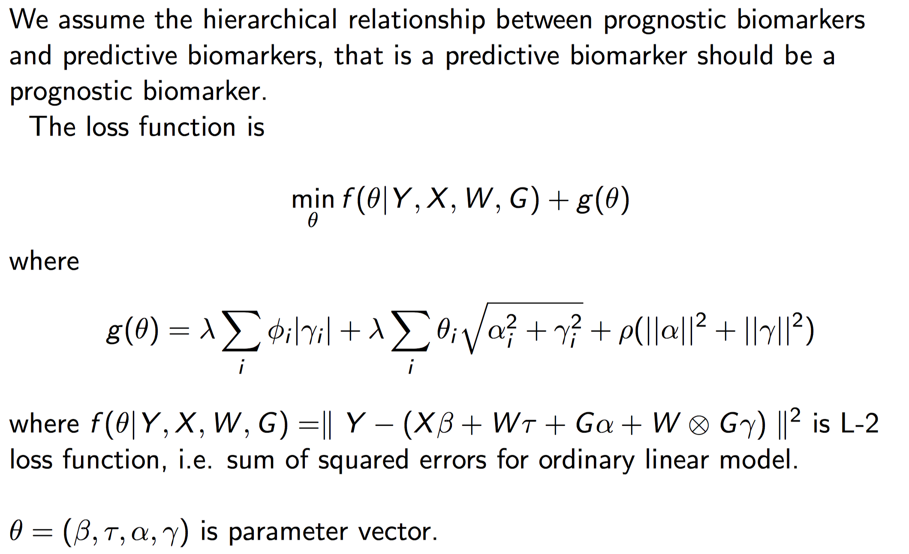
Loss Function

Slide 8
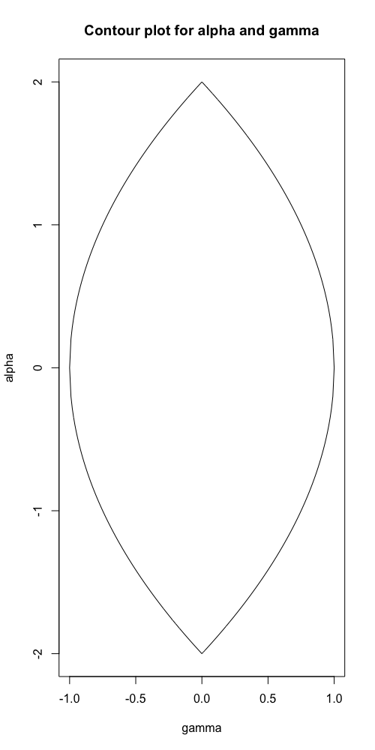

Slide 9
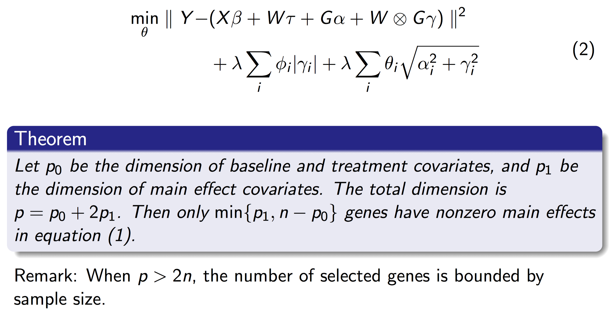
Elastic Net

Slide 10
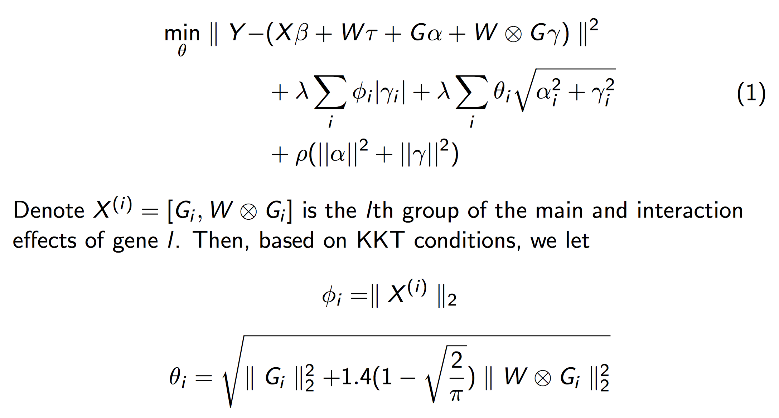
Adaptive Weights

Slide 11
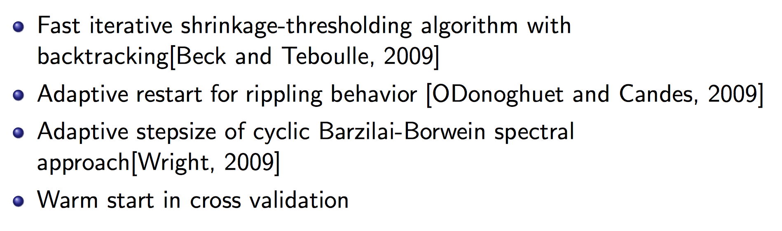
Optimization Strategies

Slide 12
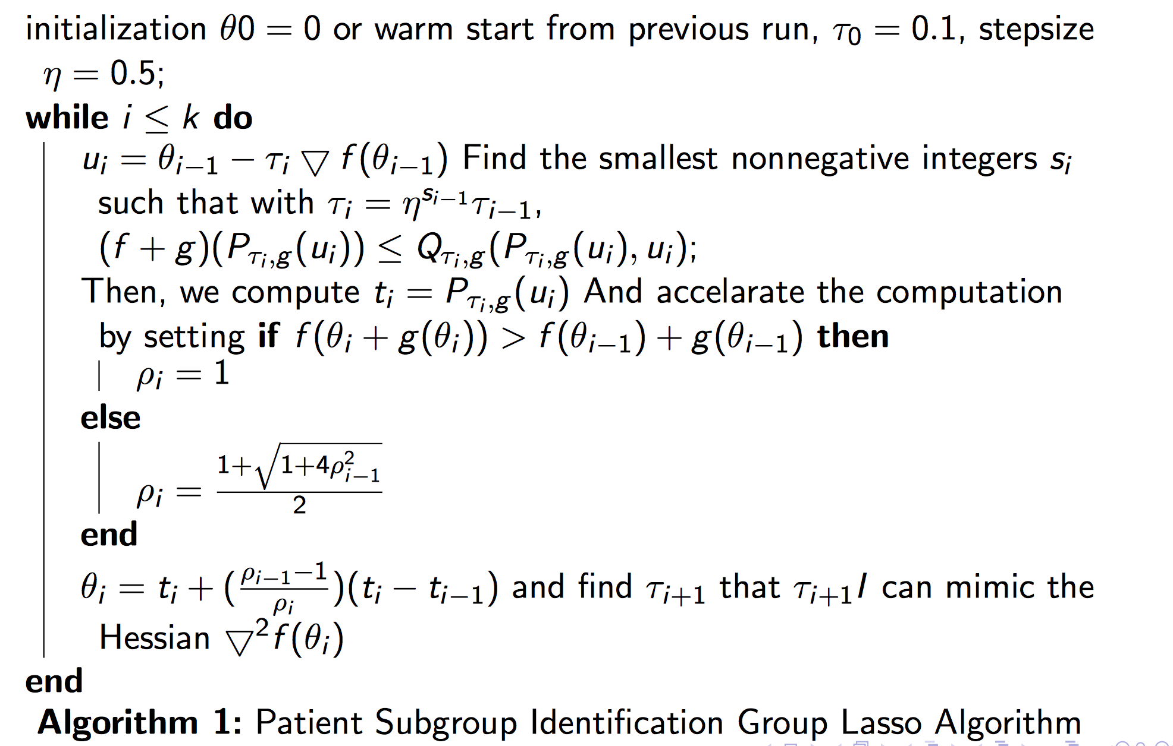
Algorithm

Slide 13
Simulations

Slide 14
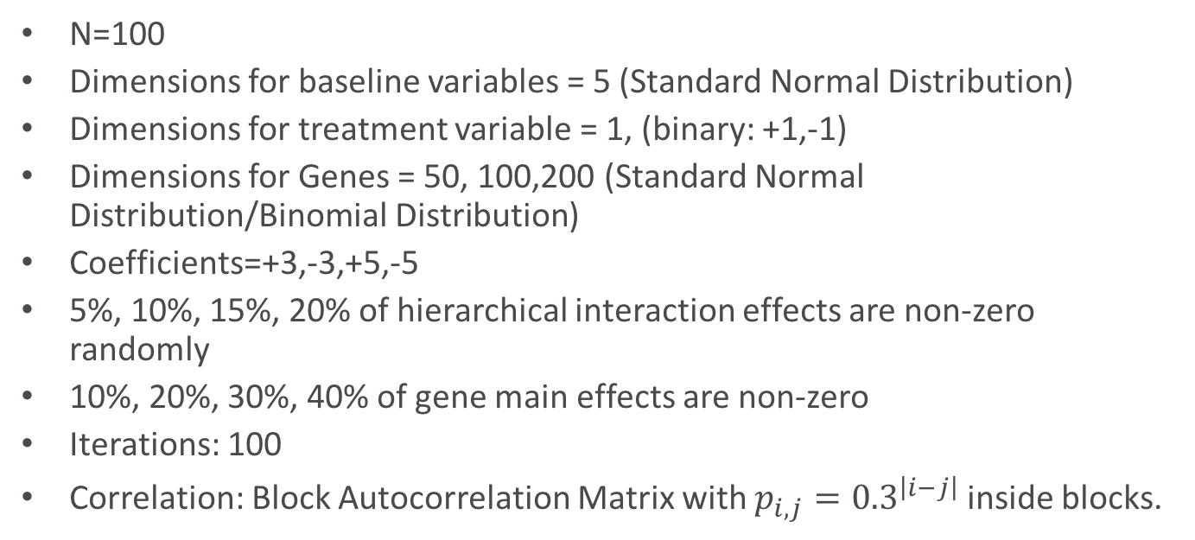
Simulation Setup
N=100
Dimensions for baseline variables = 5 (Standard Normal Distribution)
Dimensions for treatment variable = 1, (binary: +1,-1)
Dimensions for Genes = 50, 100,200 (Standard Normal Distribution/Binomial Distribution)
Coefficients=+3,-3,+5,-5
5%, 10%, 15%, 20% of hierarchical interaction effects are non-zero randomly
10%, 20%, 30%, 40% of gene main effects are non-zero
Iterations: 100
Correlation: Block Autocorrelation Matrix with $p_{i,j}={0.3}^{\left|i−j\right|}$ inside blocks.

Slide 15

Signal/Noise ratio (SNR)
For 100 genes: 1, 5, 10, 20, 100.
$SNR=\frac{var(y_{0})}{var(ε)}$, where $y=y_{0}+ε$

Slide 16
Other methods
General Elastic Net without penalizing baseline and treatment variables (Lasso)
Bayesian Model Averaging (BMA)
Stepwise Variable Selection by likelihood (step)
Iterative Sure Independent Screening (SIS)
Random Forest

Slide 17
Cross Validation and Optimal Penalty Parameters

Slide 18
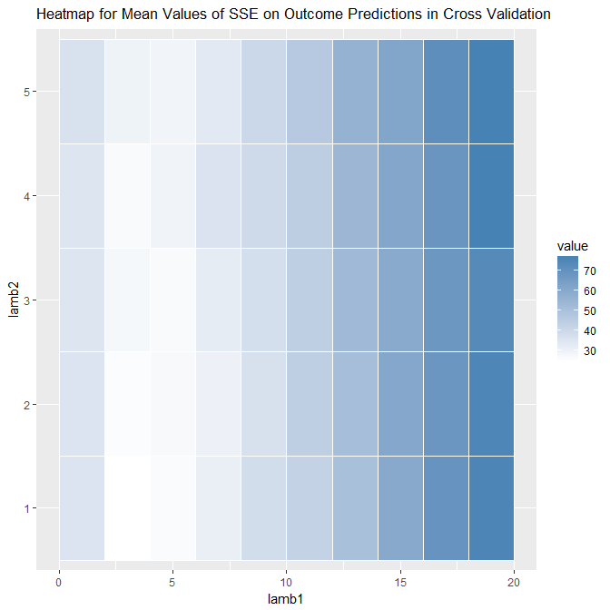
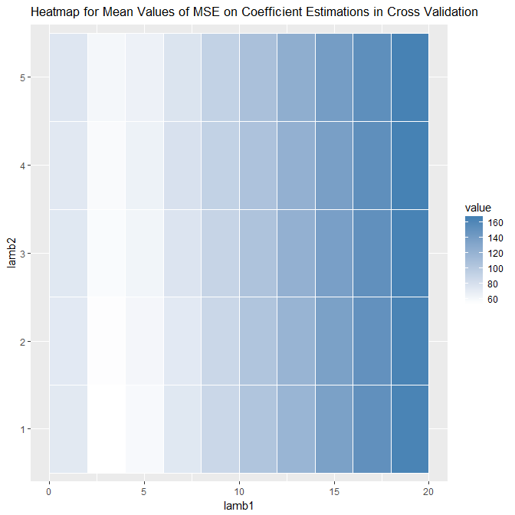
Distributions of MSE and SSE by Penalty Parameters
SSE
MSE

Slide 19
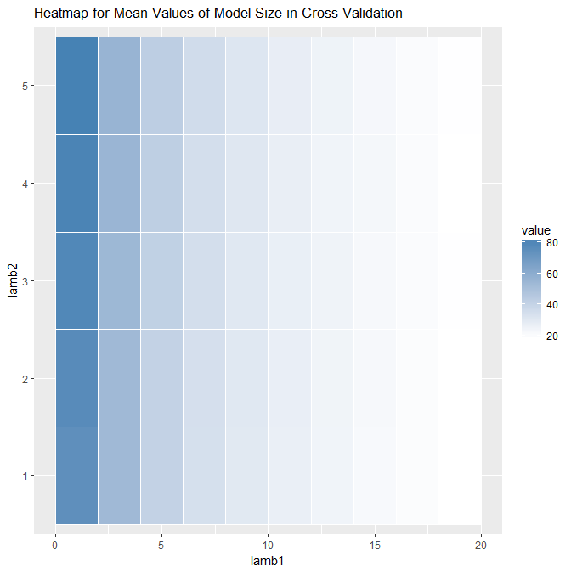
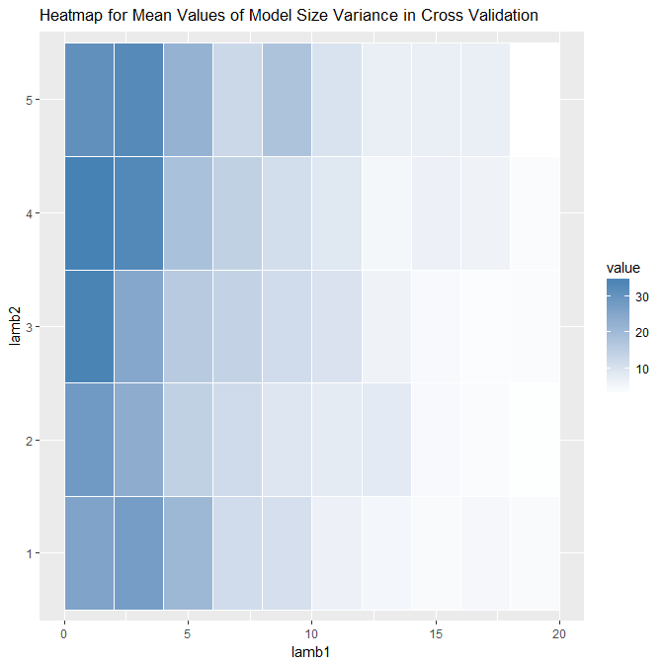
Selected Model Size
Mean of Model Size
Variance of Model Size

Slide 20
Optimal Regularization Parameters
Minimize AIC-like estimator may be a proper way for model selection, especially when we are more interested in predictive biomarkers.

Slide 21
Proportion of nonzero interactions

Slide 22
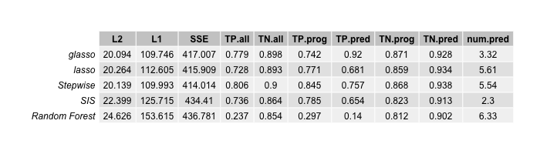
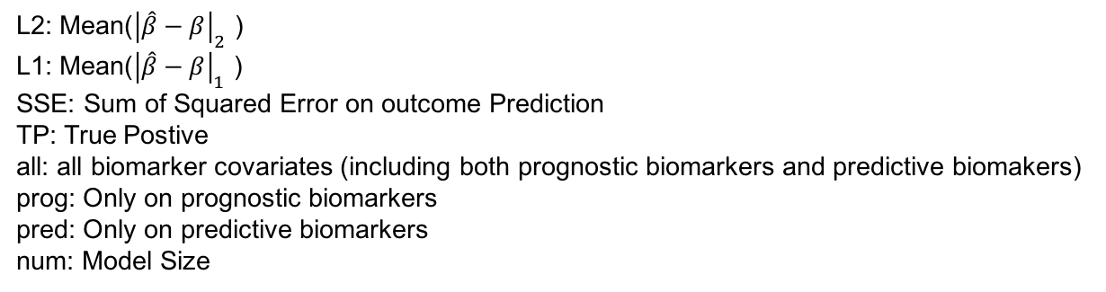
Nonzero Interaction Effects Proportion=5%
L2: Mean(${\left|\hat{β}−β\right|}_{2}$ )
L1: Mean(${\left|\hat{β}−β\right|}_{1}$ )
SSE: Sum of Squared Error on outcome Prediction
TP: True Postive
all: all biomarker covariates (including both prognostic biomarkers and predictive biomakers)
prog: Only on prognostic biomarkers
pred: Only on predictive biomarkers
num: Model Size

Slide 23
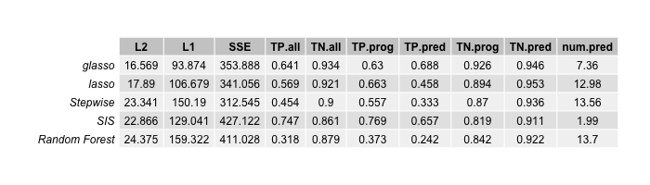
Nonzero Interaction Effects Proportion=10%
L2: Mean(${\left|\hat{β}−β\right|}_{2}$ )
L1: Mean(${\left|\hat{β}−β\right|}_{1}$ )
SSE: Sum of Squared Error on outcome Prediction
TP: True Postive
all: all biomarker covariates (including both prognostic biomarkers and predictive biomakers)
prog: Only on prognostic biomarkers
pred: Only on predictive biomarkers
num: Model Size

Slide 24
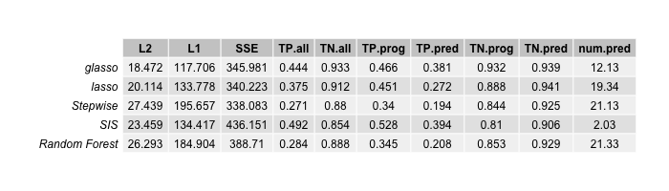
Nonzero Interaction Effects Proportion=0.15
L2: Mean(${\left|\hat{β}−β\right|}_{2}$ )
L1: Mean(${\left|\hat{β}−β\right|}_{1}$ )
SSE: Sum of Squared Error on outcome Prediction
TP: True Postive
all: all biomarker covariates (including both prognostic biomarkers and predictive biomakers)
prog: Only on prognostic biomarkers
pred: Only on predictive biomarkers
num: Model Size

Slide 25
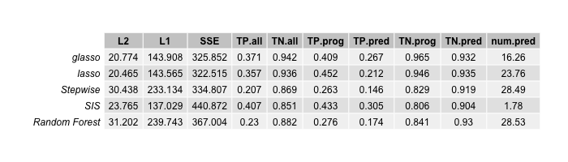
Nonzero Interaction Effects Proportion=0.2
L2: Mean(${\left|\hat{β}−β\right|}_{2}$ )
L1: Mean(${\left|\hat{β}−β\right|}_{1}$ )
SSE: Sum of Squared Error on outcome Prediction
TP: True Postive
all: all biomarker covariates (including both prognostic biomarkers and predictive biomakers)
prog: Only on prognostic biomarkers
pred: Only on predictive biomarkers
num: Model Size

Slide 26
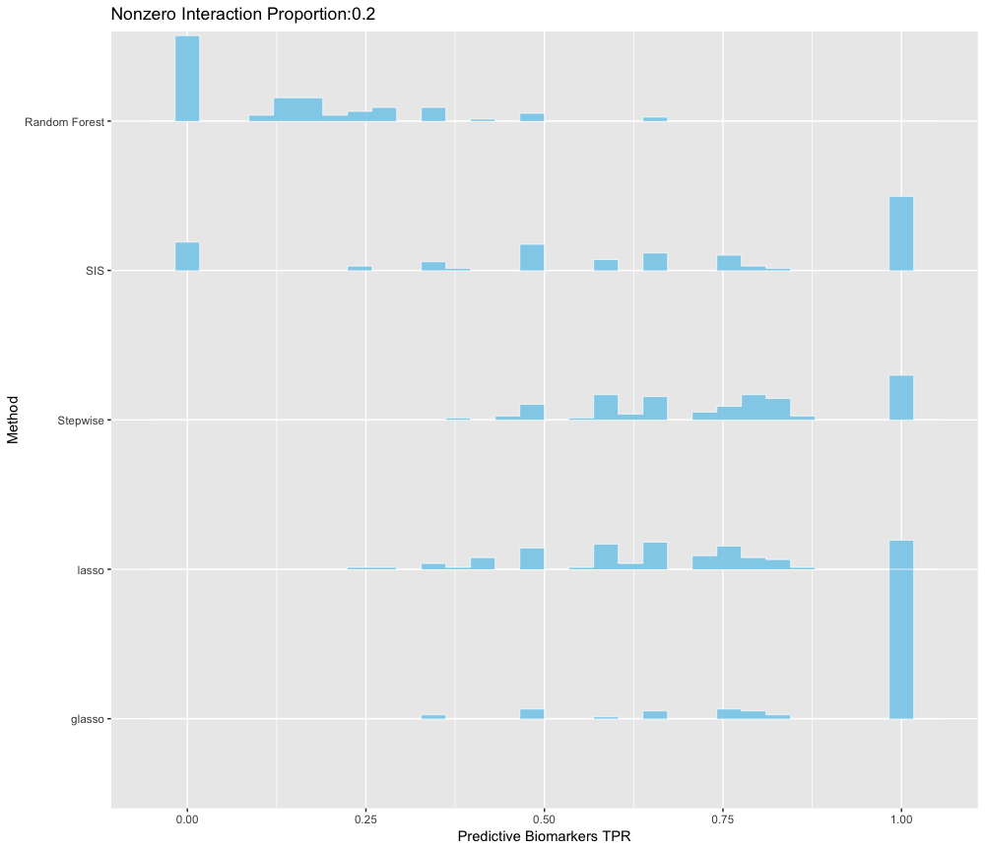
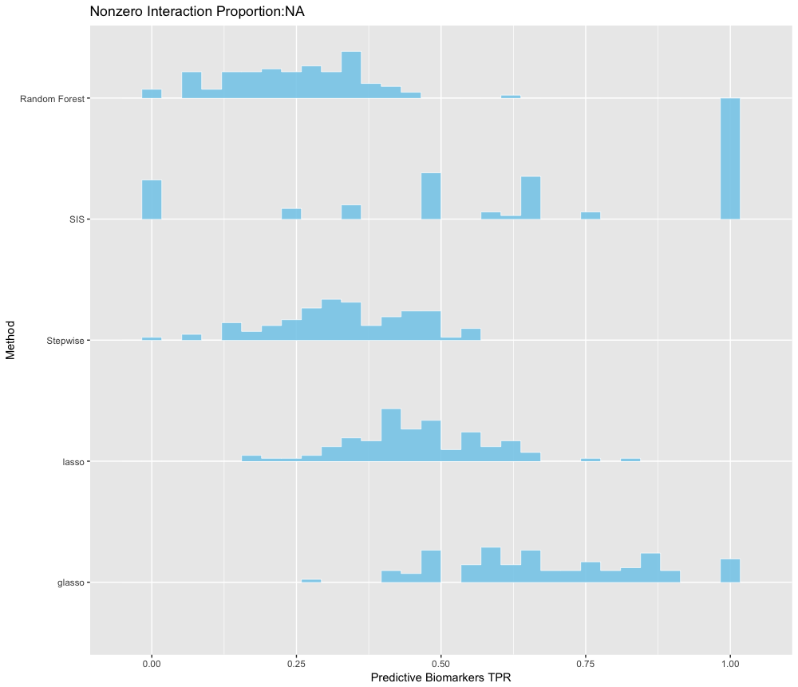
Distributions of TPR on Predictive Biomarkers Across All Simulations
Proportion=5%
Proportion=10%

Slide 27
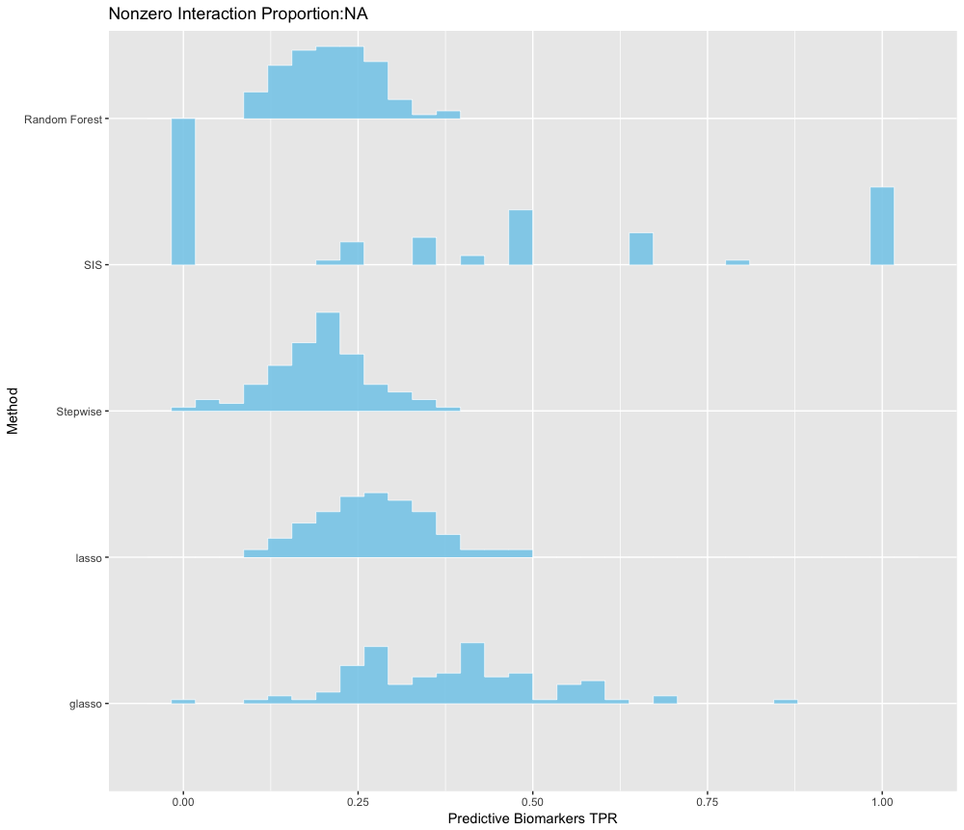
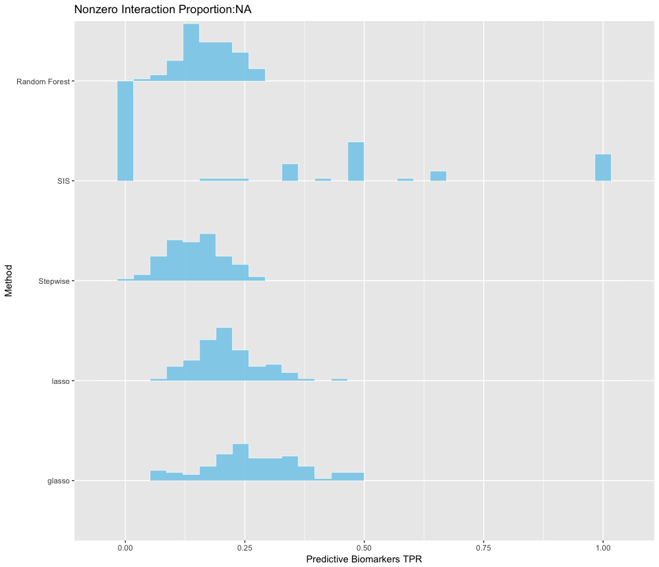
Distributions of TPR on Predictive Biomarkers Across All Simulations
Proportion=15%
Proportion=20%

Slide 28
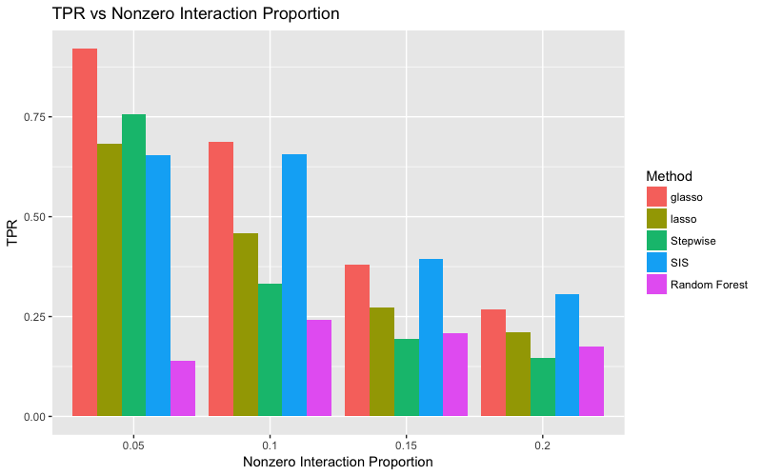

Slide 29
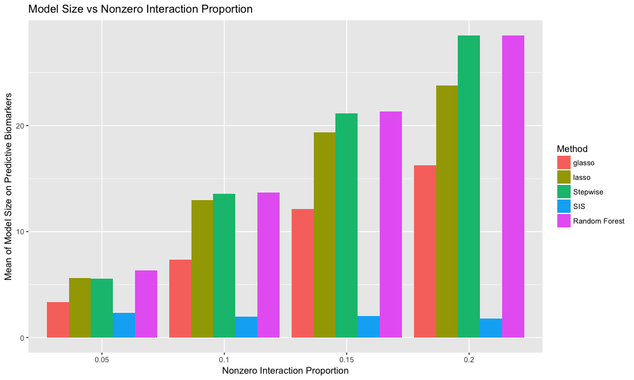

Slide 30
Signal Noise Ratio

Slide 31

SNR=1
L2: Mean(${\left|\hat{β}−β\right|}_{2}$ )
L1: Mean(${\left|\hat{β}−β\right|}_{1}$ )
SSE: Sum of Squared Error on outcome Prediction
TP: True Postive
all: all biomarker covariates (including both prognostic biomarkers and predictive biomakers)
prog: Only on prognostic biomarkers
pred: Only on predictive biomarkers
num: Model Size

Slide 32
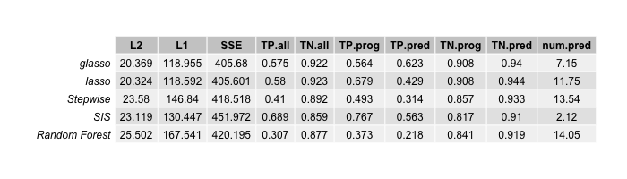
SNR=5
L2: Mean(${\left|\hat{β}−β\right|}_{2}$ )
L1: Mean(${\left|\hat{β}−β\right|}_{1}$ )
SSE: Sum of Squared Error on outcome Prediction
TP: True Postive
all: all biomarker covariates (including both prognostic biomarkers and predictive biomakers)
prog: Only on prognostic biomarkers
pred: Only on predictive biomarkers
num: Model Size

Slide 33
SNR=10
L2: Mean(${\left|\hat{β}−β\right|}_{2}$ )
L1: Mean(${\left|\hat{β}−β\right|}_{1}$ )
SSE: Sum of Squared Error on outcome Prediction
TP: True Postive
all: all biomarker covariates (including both prognostic biomarkers and predictive biomakers)
prog: Only on prognostic biomarkers
pred: Only on predictive biomarkers
num: Model Size

Slide 34

SNR=20
L2: Mean(${\left|\hat{β}−β\right|}_{2}$ )
L1: Mean(${\left|\hat{β}−β\right|}_{1}$ )
SSE: Sum of Squared Error on outcome Prediction
TP: True Postive
all: all biomarker covariates (including both prognostic biomarkers and predictive biomakers)
prog: Only on prognostic biomarkers
pred: Only on predictive biomarkers
num: Model Size

Slide 35
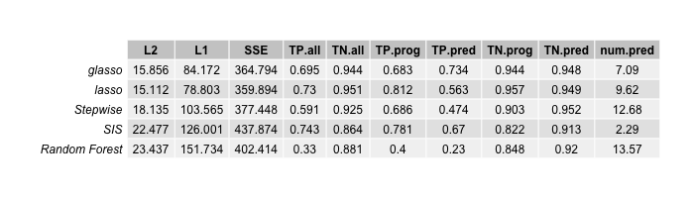
SNR=100
L2: Mean(${\left|\hat{β}−β\right|}_{2}$ )
L1: Mean(${\left|\hat{β}−β\right|}_{1}$ )
SSE: Sum of Squared Error on outcome Prediction
TP: True Postive
all: all biomarker covariates (including both prognostic biomarkers and predictive biomakers)
prog: Only on prognostic biomarkers
pred: Only on predictive biomarkers
num: Model Size

Slide 36
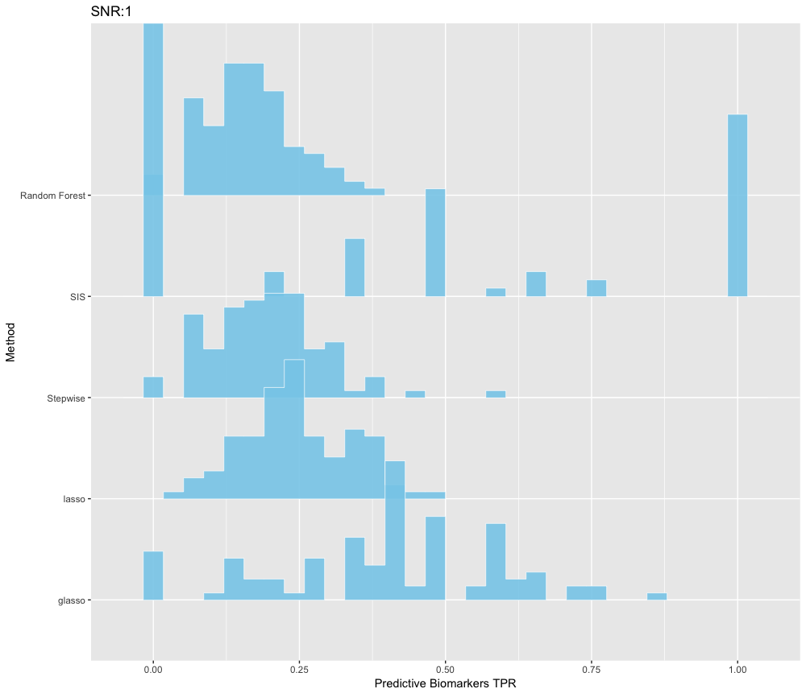
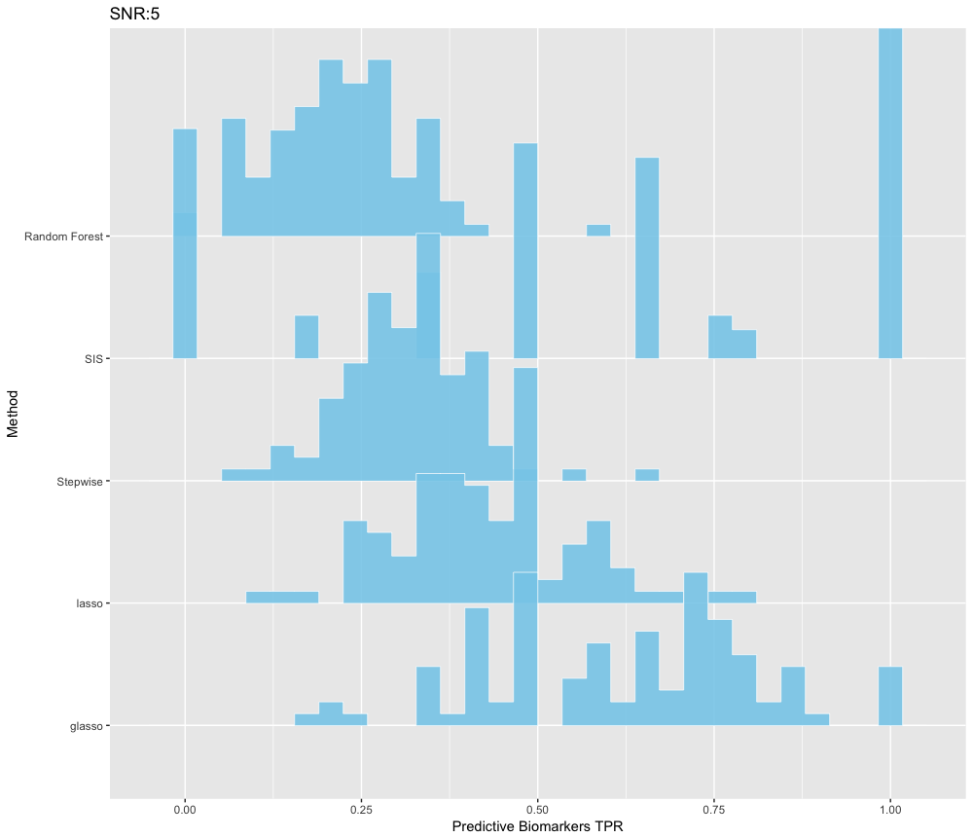
Distributions of TPR on Predictive Biomarkers Across All Simulations
SNR=1
SNR=5

Slide 37
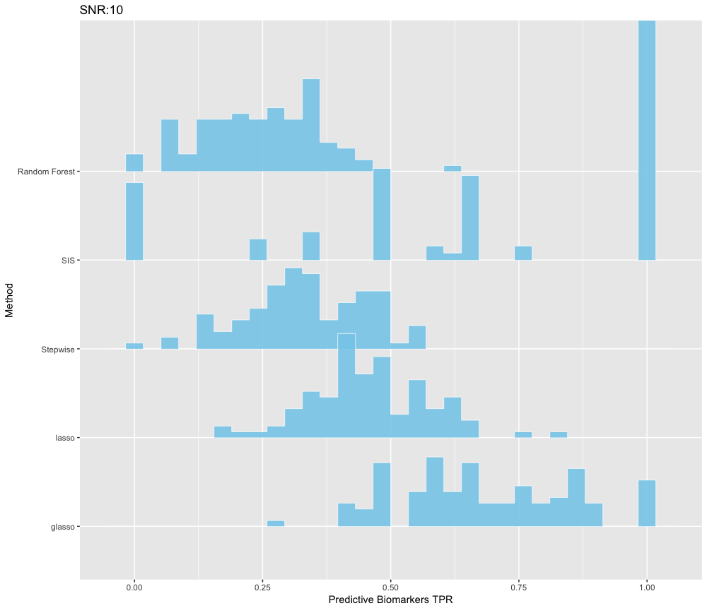
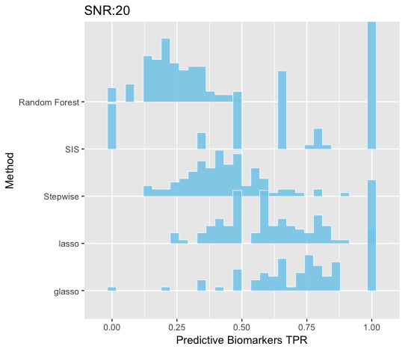
Distributions of TPR on Predictive Biomarkers Across All Simulations
SNR=10
SNR=20

Slide 38
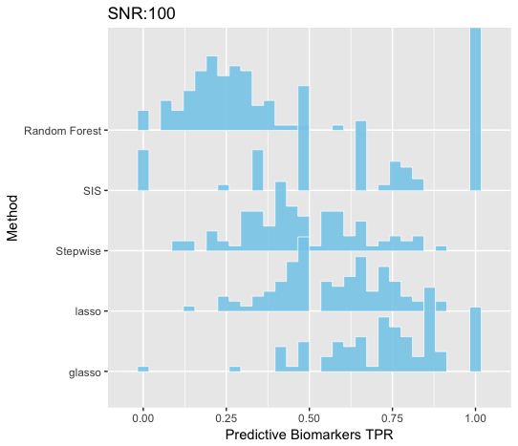
Distributions of TPR on Predictive Biomarkers Across All Simulations
SNR=100

Slide 39
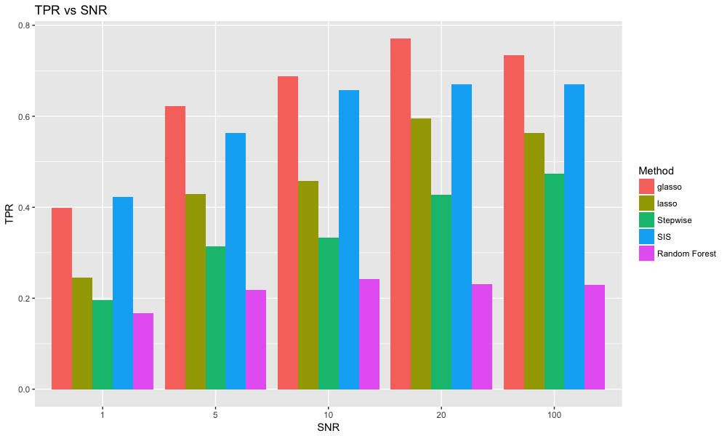

Slide 40
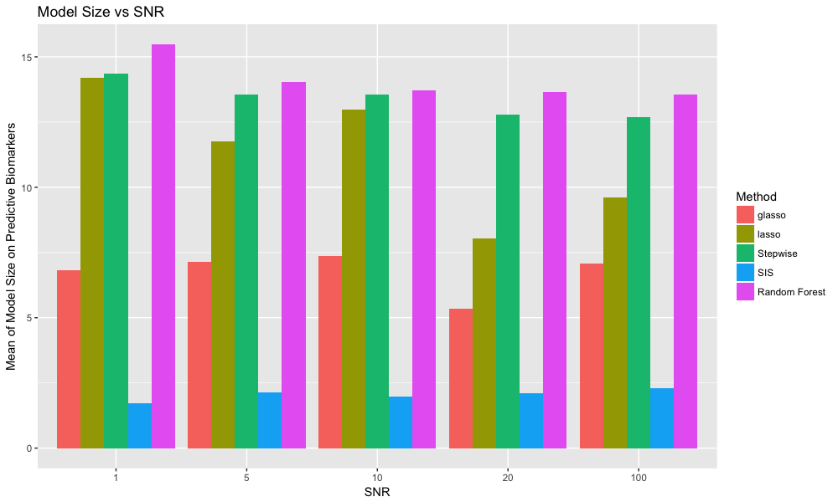

Slide 41
Other number of biomakers

Slide 42
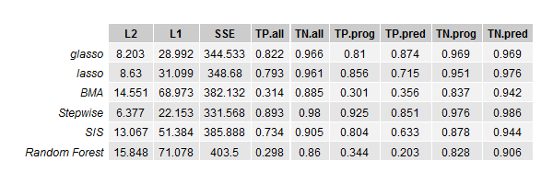
Dimension of genes=50 and total dimension=106

Slide 43
When number of biomarkers > sample size

Slide 44
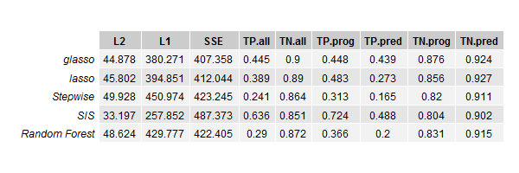
Dimension of genes=200 and total dimension=406

Slide 45
When covariates are SNP

Slide 46
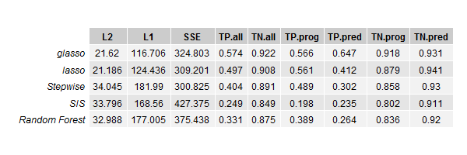
SNP

Slide 47
Real Data

Slide 48
Future Steps
Overlapping Simulations
Stop Criterion
Combination of
Endpoints

Slide 49
References

Slide 50
Thanks!

